Slide 1
PROBABILITY DISTRIBUTIONS

Slide 2
Definition of random variables and probability distributions
Given an experiment and the corresponding set of possible outcomes (the sample space), a random variable associates a particular number with each outcome. Mathematically, a random variable is a real-valued function of the experimental outcome. The following are some examples of random variables:

Slide 3
(a) In an experiment involving a sequence of 5 tosses of a coin, the number of heads in the sequence is a random variable.
(b) In an experiment involving two rolls of a die, the following are examples of random variables: (1) The sum of the two rolls, (2) The number of sixes in the two rolls.
(c) In an experiment involving the transmission of a message, the time needed to transmit the message, the number of symbols received in error, and the delay with which the message is received are all random variables.

Slide 4
Notation: We will use capital letters to denote random variables, and lower case characters to denote real numbers such as the numerical values of a random variable.
Types of random variables: Generally, two types of random variables exist: discrete and continuous. A random variable is called discrete if its range (the set of values that it can take) is finite or at most countably infinite. For instance, the number of children in a family, number of car accidents within given period of time in a certain locality, the number of bacteria in a cubic mm of agar, etc.
If random variable assumes any numerical value in an interval or collection of intervals, then it is called a continuous random variable.

Slide 5
Examples include body weight of new born baby, life time of a human being, height of a person, etc.
The most important way to characterize a random variable is through the probabilities of the values that it can take. For a discrete random variable X, these are captured by the probability mass function (p.m.f. for short) of X, denoted P_{X}(x). For a continuous random variable X it is done by the probability density function (p.d.f.), denoted f_{X}(x).

Slide 6
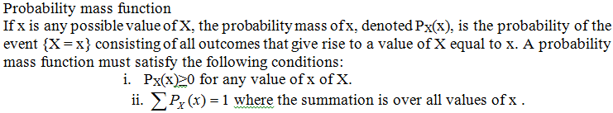

Slide 7
Example 6.1: Consider an experiment of tossing two fair coins. Letting X denote the number of heads appearing on the top face, then X is a random variable taking on one of the values 0, 1, 2 . The random variable X assigns a 0 value for the outcome (T,T), 1 for outcomes (T ,H) and (H, T ), and 2 for the outcome (H,H). Thus, we can calculate the probability that X can take specific value/s as follows:
P(X = 0) = P({(T , T )}) = ¼
P(X = 1) = P({(T ,H),(H, T )}) = 2/4,
P(X = 2) = P({(H,H)}) = ¼

Slide 8
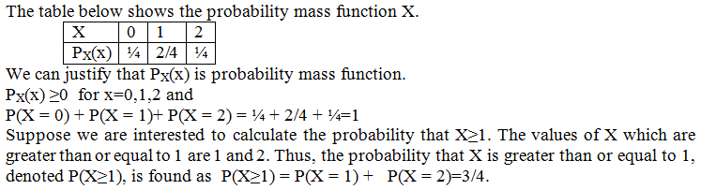

Slide 9
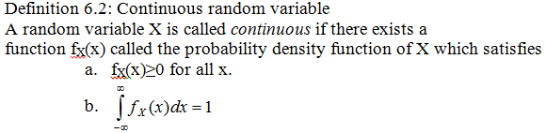

Slide 10
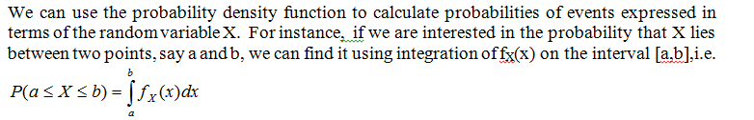

Slide 11
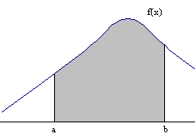
Figure: P (a≤ X ≤ b) is the shaded region

Slide 12
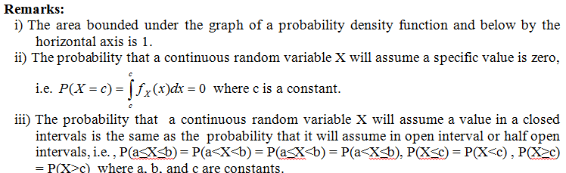

Slide 13
Introduction to expectation: mean and variance
We can associate with each random variable certain “averages” of interest, such as mean and variance which give useful summary of a probability distribution.

Slide 14
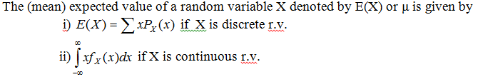

Slide 15
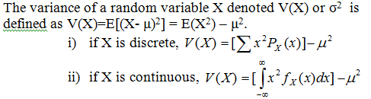
Variance

Slide 16
The variance provides a measure of dispersion of X around its mean. Another measure of dispersion is the standard deviation of X, which is defined as the square root of the variance and is denoted by σ.

Slide 17
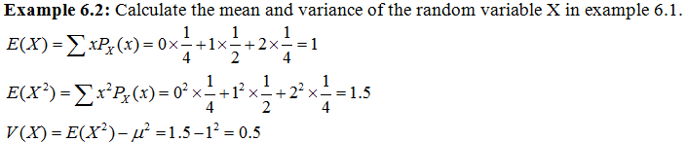

Slide 18
Common discrete probability distributions – binomial and Poisson
The Binomial distribution
Many real problems (experiments) have two possible outcomes, for instance, a person may be HIV-Positive or HIV-Negative, a seed may germinate or not, the sex of a new born bay may be a girl or a boy, etc. Technically, the two outcomes are called Success and Failure.
Experiments or trials whose outcomes can be classified as either a “success” or as a “failure” are called Bernoulli trails.

Slide 19

Suppose that n independent trials, each of which results in a “success” with probability p and in a “failure” with probability 1 − p, are to be performed. If X represents the number of successes that occur in the n trials, then X is said to have binomial distribution with parameters n and p. The probability mass function of a binomial distribution with parameters n and p is given by

Slide 20
The mean and variance of the binomial distribution are np and np(1-p), respectively. Note that the binomial distributions are used to model situations where there are just two possible outcomes, success and failure. The following conditions also have to be satisfied.
There must be a fixed number of trials called n
The probability of success (called p) must be the same for each trial.
The trials must be independent

Slide 21
Example 6.3: A fair coin is flipped 4 times. Let X be the number of heads appearing out of the four trials. Calculate the following probabilities:
2 heads will appear
No head will appear
At least two heads will appear
Less than two heads will appear
At most heads 2 will appear

Slide 22
Solution: We can consider that the outcomes of each trial are independent to each other. In addition the probability that a head will appear in each trial is the same. Thus, X has a binomial distribution with number of trials 4 and probability of success (the occurrence of head in a trial) is ½. The probability mass function of X is given by

Slide 23
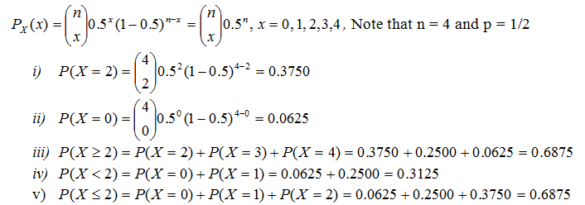

Slide 24
Example 6.5: Suppose it is known that the probability of recovery for a certain disease is 0.4. If random sample of 10 people who are stricken with the disease are selected, what is the probability that:
(a) exactly 5 of them will recover?
(b) at most 9 of them will recover?

Slide 25
Solution: Let X be the number of persons will recover from the disease. We can assume that the selection process will not affect the probability of success (0.4) for each trial by assuming a large diseased population size. Hence, X will have a binomial distribution with number of trials equal to 10 and probability of success equal 0.4.

Slide 26
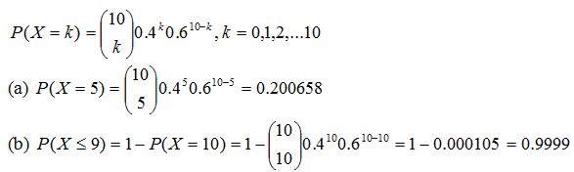

Slide 27

The Poisson Random Variable
A random variable X, taking on one of the values 0, 1, 2, . . . , is said to have a Poisson distribution if its probability mass function is given by

Slide 28
λ is the parameter of this distribution. The mean and variance of the poisson distribution are equal and their values are equal to λ. Note that poisson distributions is used to model situations where the random variable X is the number of occurrences of a particular event over a given period of time (or space).

Slide 29
Together with this , the following conditions must also be fulfilled: events are independent of each other, events occur singly, and events occur at a constant rate (in other words for a given time interval the mean number of occurrences is proportional to the length of the interval).
The poisson distribution is used as a distribution of rare events such as telephone calls made to a switch board in a given minute, number of misprints per page in a book, road accidents on a particular motor way in one day, etc.
The process that give rise to such events are called poisson processes.

Slide 30
Example 6.6: Suppose that the number of typographical errors on a single page of this lecture note has a Poisson distribution with parameter λ = 1. if we randomly select a page in this lecture note, calculate the probability that
no error will occur.
exactly three errors will occur.
less than 2 errors will occur.
there is at least one error.

Slide 31
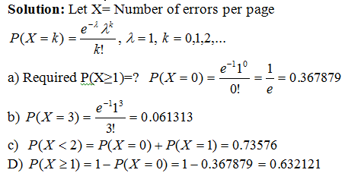

Slide 32
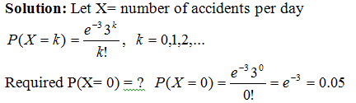
Example 6.7: If the number of accidents occurring on a highway each day is a Poisson random variable with parameter λ = 3, what is the probability that no accidents will occur on a randomly selected day in the future?

Slide 33

Note: The Poisson random variable has a wide range of applications in a diverse number of areas. An important property of the Poisson random variable is that it may be used to approximate a binomial random variable when the binomial parameter n is large and p is small. The probability that X will be k can be approximated by substituting λ by np in the poisson distribution, i.e.

Slide 34
Common examples of continous probability distribution
Normal distribution
Student’s T distribution
F distribution

Slide 35
Normal distribution
The normal distribution plays an important role in statistical inference because many real-life distributions are approximately normal;
many other distributions can be almost normalized by appropriate data transformations (e.g., taking the log) and as a sample size increases, the means of samples drawn from a population of any distribution will approach the normal distribution.

Slide 36
A continuous random variable X is said to follow normal distribution , if and only if , its probability density function (p.d.f.) is:

Slide 37
There are infinitely many normal distributions since different values of μ and σ define different normal distributions. For instance, when μ= 0 and σ =1 , the above density will have the following form

Slide 38
This particular distribution is called the standard normal distribution and sometimes known as Z-distribution. The random variable corresponding to this distribution is usually denoted by Z. If X has a normal distribution with mean μ and variance σ², we denote it as

Slide 39
Properties of normal distribution
The normal distribution curve is a bell shaped, symmetrical about μ and mesokurtic. The p.d.f. attains its maximum value at x= μ.
Since for x= μ divides the area under the normal curve into two equal parts, μ is the mean, the median and the mode of the distribution.
The mean and variance of the normal distribution are μ, and σ², respectively.

Slide 40
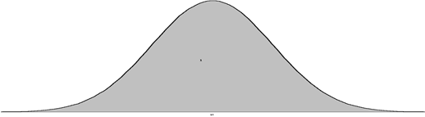
Properties of normal distribution cont….
The total area under the curve and bounded from below by the horizontal axis is 1, i.e
Figure: The shaded area under the normal curve is one

Slide 41
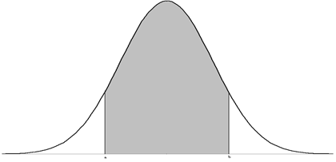
Since a normal distribution is a continuous probability distribution, the probability that X lies between a and b is the area bounded under the curve, from left to right by the vertical lines x = a and x = b and below by the horizontal axis.
Figure: P(a<X<b) equals the shaded region

Slide 42
However, evaluating
is very complicated.
To facilitate this problem, we use the standard normal table which gives area values bounded by two points.
Areas under the standard normal distribution curve are tabulated in various ways. The most common tables give areas bounded between Z=0 and a positive value of Z.

Slide 43
In addition to the standard normal table, the properties of normal distribution and the following theorem are useful to make probability calculations very easy for any normal distribution.

Slide 44
Standardization of a normal random variable
If X has a normal distribution with mean, μ and standard deviation ,σ , then
will have a standard normal distribution.

Slide 45
Let Z be the standard normal random variable. Calculate the following probabilities using the standard normal distribution table:
a) P(0<Z<1.2)
b) P(0<Z<1.43)
c) P(Z≤0)
d) P(-1.2<Z<0)
e) P(Z≤-1.43)
f) P(-1.43≤Z<1.2)
g) P(Z≥1.52)
h) P(Z≥-1.52)

Slide 46
Solution:
The probability that Z lies between 0 and 1.2 can be directly found from the standard normal table as follows: look for the value 1.2 from z column ( first column) and then move horizontally until you find the value of 0.00 in the first row. The point of intersection made by the horizontal and vertical movements will give the desired area (probability). Hence P(0<Z<1.2)= 0.3849. Refer the table below as a guide to find this probability.
standard normal table.docx T test and F test.docx

Slide 47
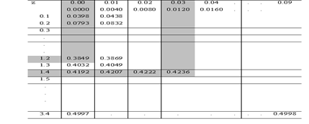

Slide 48
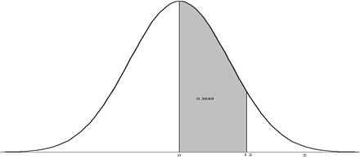
Figure: P(0<Z<1.2) is the shaded area

Slide 49
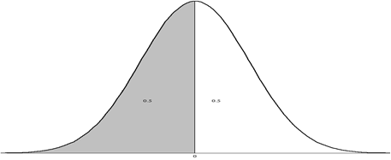
In a similar way P(0<Z<1.43)= 0.4236.
We know that the normal distribution is symmetric about its mean. Hence the area to the left of 0 and the to the right of zero are 0.5 each. Therefore P(Z≤0)=P(Z≥0)=0.5

Slide 50
d) P(-1.2<Z<0)=P(0<Z<1.2)= 0.3849 due to symmetry
e) P(Z<-1.43)= 1- P(Z ≥ -1.43) Using the probability of the complement event.
= 1-[P(-1.43<Z<0)+P(Z≥0)] Since a region can be broken down =1-[P(0<Z<1.43)+P(Z ≥0)] into non overlapping regions.
=1-[0.4236 + 0.5]
=1-0.9236=0.0764

Slide 51
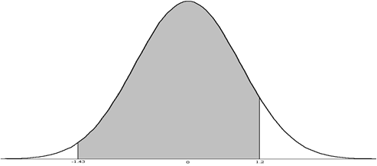
F) P(-1.43≤Z<1.2) = P(-1.43≤Z<0) + P(0≤Z<1.2)=P(0<Z≤1.43) + 0.3849= 0.4236 + 0.3849 =0.8085
Figure: P(-1.43≤Z<1.2) is the shaded region

Slide 52
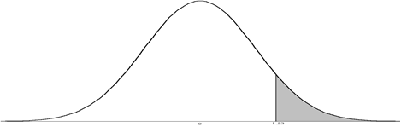
P(Z≥1.52) = 0.5 – P(0≤ Z<1.52)=0.5 – 0.4357=0.0643
Figure: P(Z≥1.52) is the shaded region

Slide 53
h) P(Z≥-1.52) = P(-1.52≤Z<0) + P(Z ≥0 )= P(0 < Z≤1.52) + 0.5 =0.4357 +0.5=0.9357

Slide 54
Example: Find the following values of z* of a standard normal random variable based on the given probability values:
P(Z > z*) =0.1446
P(Z>z*) = 0.8554
Solution: We need to find specific values of Z given some probability values.
If the probability that Z>z* is 0.1446 implies that z* is to the right of zero because
P(Z>0) = 0.5 is greater than P(Z>z*).

Slide 55
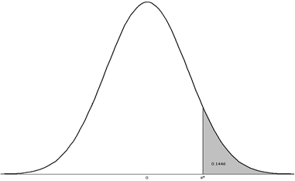
P(Z > z*) = 0.1446 implies that P(0<Z≤z*) = 0.5 -0.1446=0.3554.
Hence we can look for the value of z* satisfying the above condition form the standard normal table. Thus z* =1.06

Slide 56
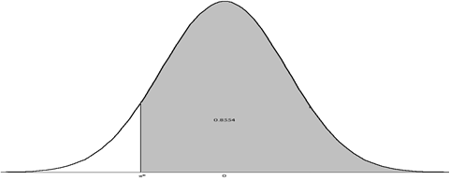
If the probability that Z>z* is 0.8554 implies that z* is to the left of zero because P(Z>0) = 0.5 is less than P(Z>z*). It implies that z* is a negative number.

Slide 57
P(Z>z*) = 0.8554 = P(z*≤ Z <0) + P( Z ≥ 0) = P(0 ≤ Z ≤ - z*) + 0.5
Implies P(0 ≤ Z ≤ - z*) = 0.8554 – 0.5=0.3554. Hence the value –z* form the table satisfying the above condition is 1.06. Therefore z* = -1.06.

Slide 58
Example: If the total cholesterol values for a certain target population are approximately normally distributed with a mean of 200 (mg/100 ml) and a standard deviation of 20 (mg/100 ml), calculate the probability that a person picked at random from this population will have a cholesterol value
greater than 240 (mg/100 ml)
between 180 and 220(mg/100 ml)
less 200 (mg/100 ml)

Slide 59
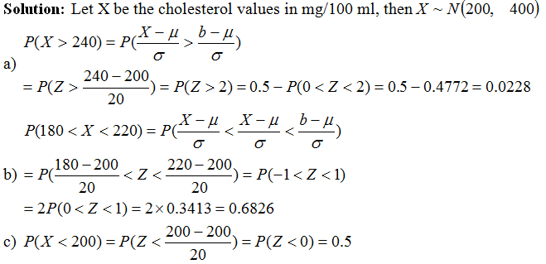

Slide 60
Assume that the test scores for a large class are normally distributed with a mean of 74 and a standard deviation of 10.
Suppose that you receive a score of 88. What percent of the class received scores higher than yours?
Suppose that the teacher wants to limit the number of A grades in the class to no more than 20%. What would be the lowest score for an A?

Slide 61
